Slide 1
Chapter 2: Operating-System Structures

Slide 2
Chapter 2: Operating-System Structures
Operating System Services
User Operating System Interface
System Calls
Types of System Calls
System Programs
Operating System Design and Implementation
Operating System Structure
Operating System Debugging
Operating System Generation
System Boot

Slide 3
Objectives
To describe the services an operating system provides to users, processes, and other systems.
To discuss the various ways of structuring an operating system.
To explain how operating systems are installed and customized and how they boot.

Slide 4
Operating System Services
Operating systems provide an environment for execution of programs and services to programs and users.
One set of operating-system services provides functions that are helpful to the user:
User interface - Almost all operating systems have a user interface (UI).
Varies between Command-Line (CLI), Graphics User Interface (GUI), Batch.
Program execution - The system must be able to load a program into memory and to run that program, end execution, either normally or abnormally (indicating error).
I/O operations - A running program may require I/O, which may involve a file or an I/O device.

Slide 5
Operating System Services (Cont.)
One set of operating-system services provides functions that are helpful to the user (Cont.):
File-system manipulation - The file system is of particular interest. Programs need to read and write files and directories, create and delete them, search them, list file Information, permission management.
Communications – Processes may exchange information, on the same computer or between computers over a network.
Communications may be via shared memory or through message passing (packets moved by the OS)
Error detection – OS needs to be constantly aware of possible errors
May occur in the CPU and memory hardware, in I/O devices, in user program.
For each type of error, OS should take the appropriate action to ensure correct and consistent computing.
Debugging facilities can greatly enhance the user’s and programmer’s abilities to efficiently use the system.

Slide 6
Operating System Services (Cont.)
Another set of OS functions exists for ensuring the efficient operation of the system itself via resource sharing.
Resource allocation - When multiple users or multiple jobs running concurrently, resources must be allocated to each of them.
Many types of resources - CPU cycles, main memory, file storage, I/O devices.
Accounting - To keep track of which users use how much and what kinds of computer resources.
Protection and security - The owners of information stored in a multiuser or networked computer system may want to control use of that information, concurrent processes should not interfere with each other
Protection involves ensuring that all access to system resources is controlled
Security of the system from outsiders requires user authentication, extends to defending external I/O devices from invalid access attempts.

Slide 7
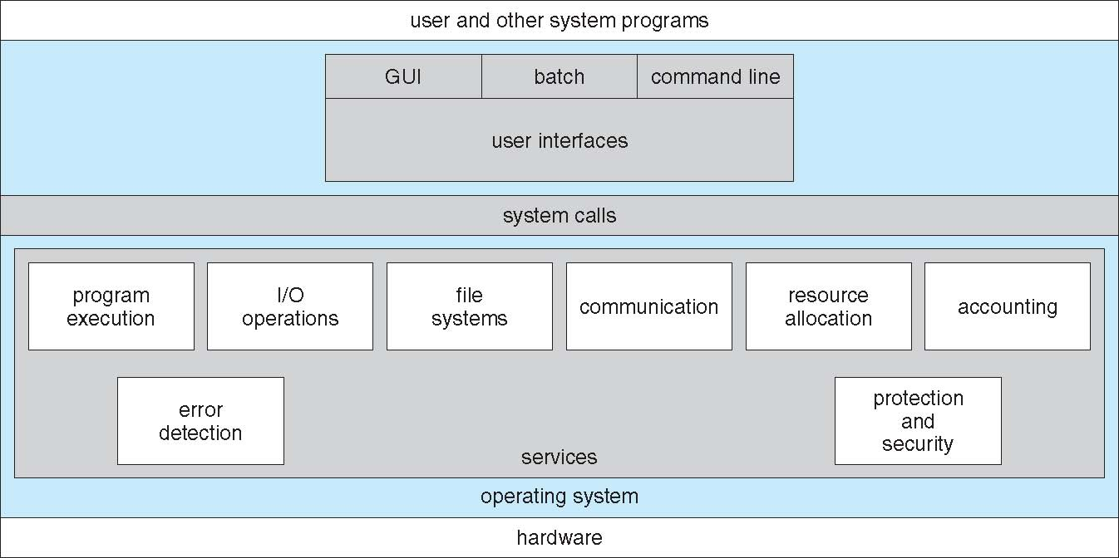
A View of Operating System Services

Slide 8
User Operating System Interface - CLI
CLI or command interpreter allows direct command entry
Sometimes implemented in kernel, sometimes by systems program.
Sometimes multiple flavors implemented – shells.
Primarily fetches a command from user and executes it.
Sometimes commands built-in, sometimes just names of programs.
If the latter, adding new features doesn’t require shell modification.

Slide 9
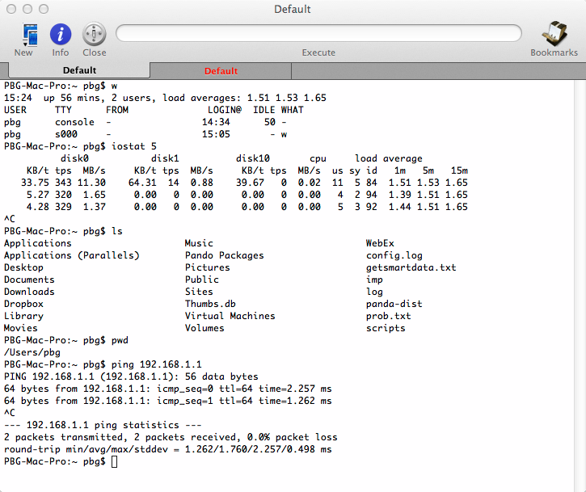
Bourne Shell Command Interpreter

Slide 10
User Operating System Interface - GUI
User-friendly desktop metaphor interface:
Usually mouse, keyboard, and monitor.
Icons represent files, programs, actions, etc
Various mouse buttons over objects in the interface cause various actions (provide information, options, execute function, open directory (known as a folder).
Invented at Xerox PARC.
Many systems now include both CLI and GUI interfaces:
Microsoft Windows is GUI with CLI “command” shell.
Apple Mac OS X is “Aqua” GUI interface with UNIX kernel underneath and shells available.
Unix and Linux have CLI with optional GUI interfaces (CDE, KDE, GNOME).

Slide 11
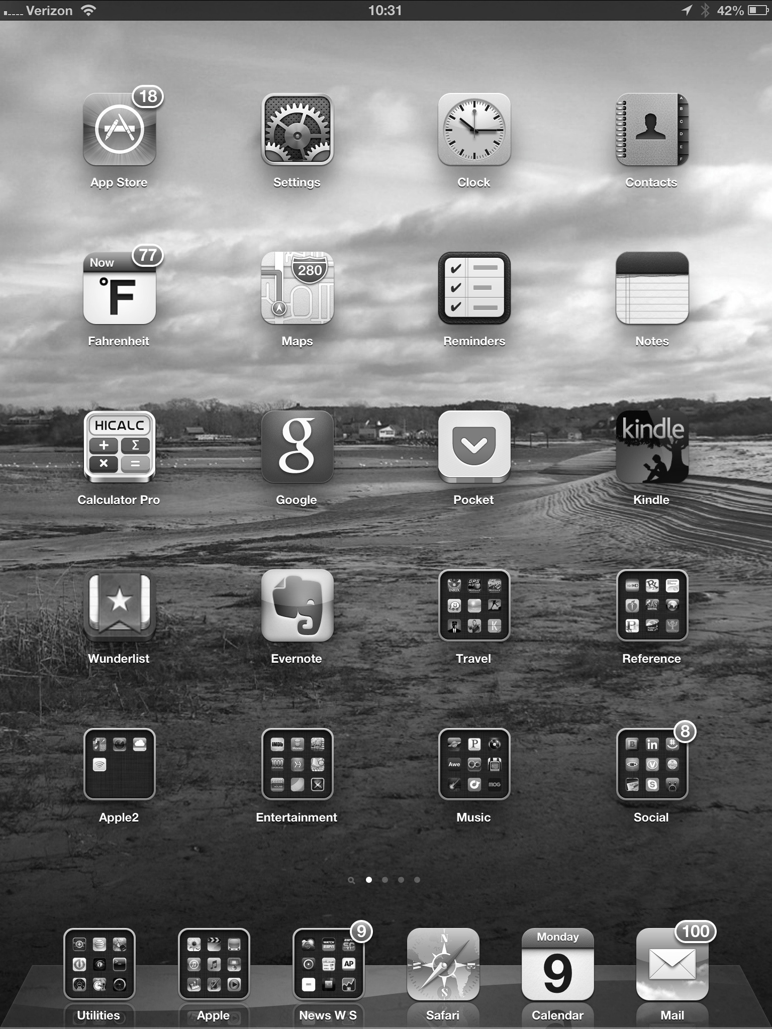
Touchscreen Interfaces
Touchscreen devices require new interfaces
Mouse not possible or not desired
Actions and selection based on gestures(for example, pressing and swiping fingers across the screen).
Virtual keyboard for text entry
Voice commands.

Slide 12
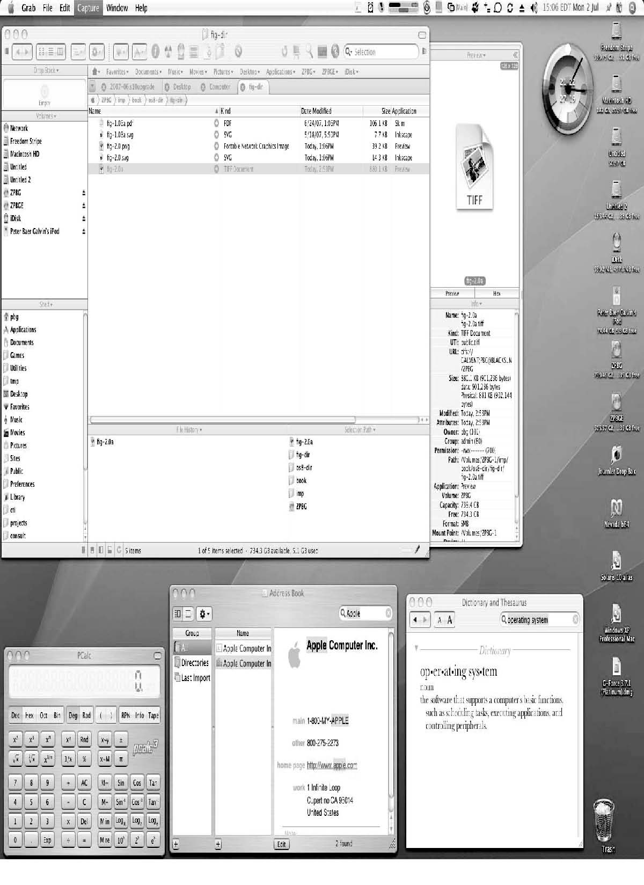
The Mac OS X GUI

Slide 13
System Calls
Programming interface to the services provided by the OS.
Typically written in a high-level language (C or C++).
Mostly accessed by programs via a high-level Application Programming Interface (API) rather than direct system call use.
Three most common APIs are Win32 API for Windows, POSIX API for POSIX-based systems (including virtually all versions of UNIX, Linux, and Mac OS X), and Java API for the Java virtual machine (JVM).
Note that the system-call names used throughout this text are generic

Slide 14
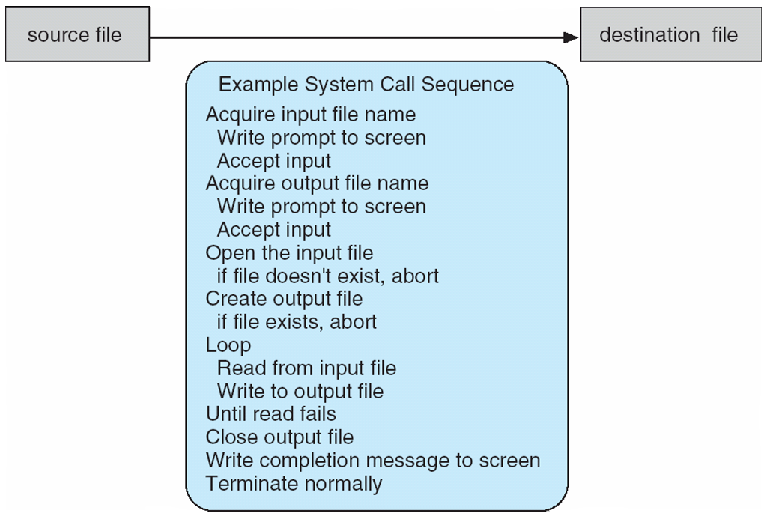
Example of System Calls
System call sequence to copy the contents of one file to another file

Slide 15
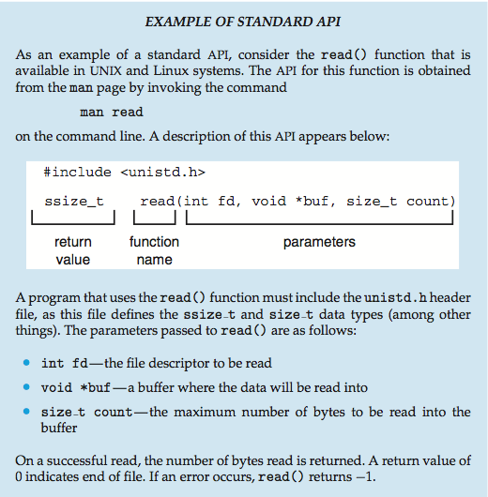
Example of Standard API

Slide 16
System Call Implementation
Typically, a number associated with each system call.
System-call interface maintains a table indexed according to these numbers.
The system call interface invokes the intended system call in OS kernel and returns status of the system call and any return values.
The caller need know nothing about how the system call is implemented
Just needs to obey API and understand what OS will do as a result call.
Most details of OS interface hidden from programmer by API
Managed by run-time support library (set of functions built into libraries included with compiler).

Slide 17
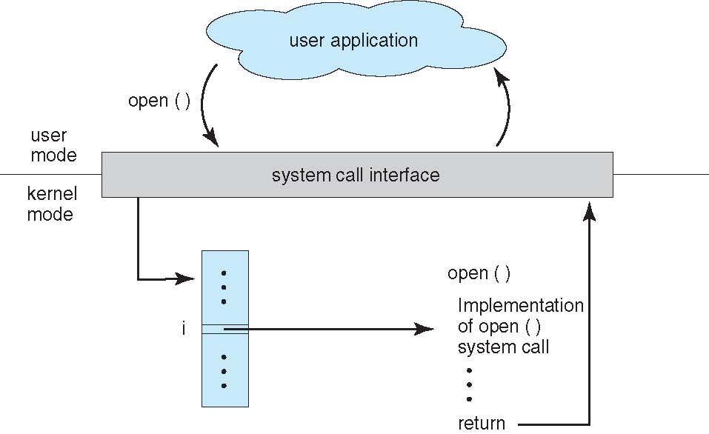
API – System Call – OS Relationship

Slide 18
System Call Parameter Passing
Often, more information is required than simply identity of desired system call
Exact type and amount of information vary according to OS and call.
Three general methods used to pass parameters to the OS
Simplest: pass the parameters in registers
In some cases, may be more parameters than registers.
Parameters stored in a block, or table, in memory, and address of block passed as a parameter in a register.
This approach taken by Linux and Solaris.
Parameters placed, or pushed, onto the stack by the program and popped off the stack by the operating system.
Block and stack methods do not limit the number or length of parameters being passed.

Slide 19
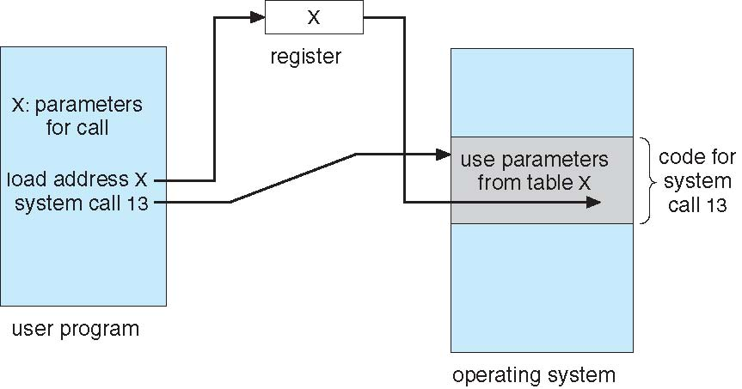
Parameter Passing via Table

Slide 20
Types of System Calls
Process control
create process, terminate process
end, abort
load, execute
get process attributes, set process attributes
wait for time
wait event, signal event
allocate and free memory
Dump memory if error
Debugger for determining bugs, single step execution.
Locks for managing access to shared data between processes

Slide 21
Types of System Calls
File management
create file, delete file
open, close file
read, write, reposition
get and set file attributes
Device management
request device, release device
read, write, reposition
get device attributes, set device attributes
logically attach or detach devices

Slide 22
Types of System Calls (Cont.)
Information maintenance
get time or date, set time or date
get system data, set system data
get and set process, file, or device attributes
Communications
create, delete communication connection
send, receive messages if message passing model to host name or process name
From client to server
Shared-memory model create and gain access to memory regions
transfer status information
attach and detach remote devices

Slide 23
Types of System Calls (Cont.)
Protection
Control access to resources
Get and set permissions
Allow and deny user access

Slide 24
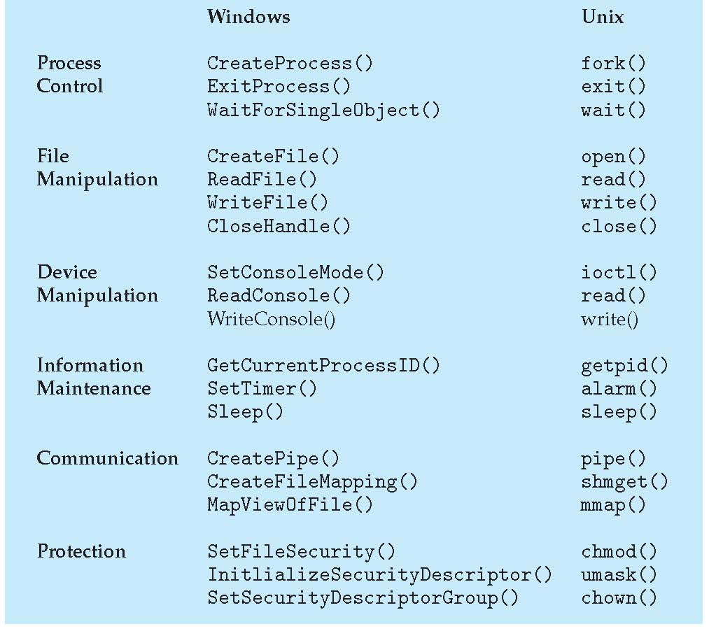
Examples of Windows and Unix System Calls

Slide 25
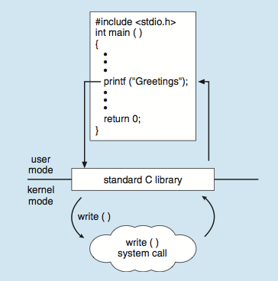
Standard C Library Example
C program invoking printf() library call, which calls write() system call

Slide 26
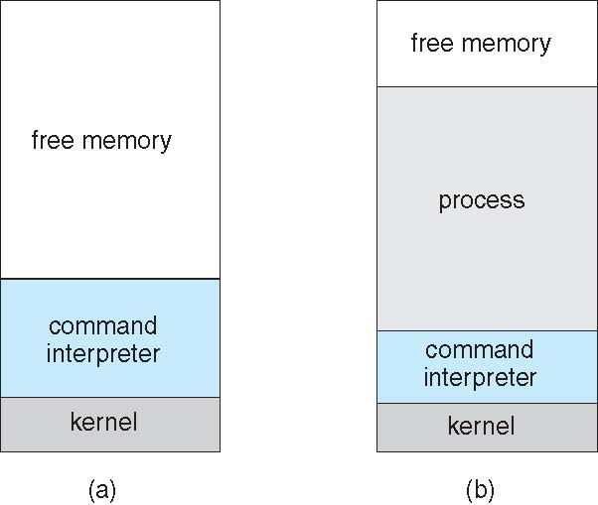
Example: MS-DOS
Single-tasking
Shell invoked when system booted
Simple method to run program
No process created
Single memory space
Loads program into memory, overwriting all but the kernel
Program exit -> shell reloaded
At system startup running a program

Slide 27
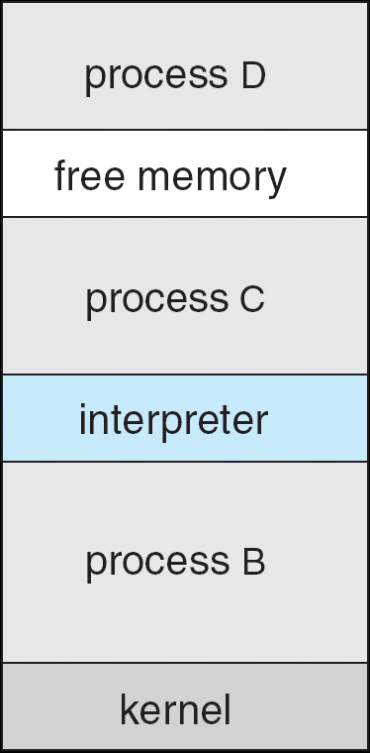
Example: FreeBSD
Unix variant
Multitasking
User login -> invoke user’s choice of shell
Shell executes fork() system call to create process
Executes exec() to load program into process
Shell waits for process to terminate or continues with user commands
Process exits with:
code = 0 – no error
code > 0 – error code

Slide 28
System Programs
System programs provide a convenient environment for program development and execution. System services, also known as system utilities, provide a convenient environment for program development and execution. Some of them are simply user interfaces to system calls. Others are consider ably more complex. They can be divided into:
File manipulation
Status information sometimes stored in a File modification
Programming language support
Program loading and execution
Communications
Background services
Most users’ view of the operation system is defined by system programs, not the actual system calls

Slide 29
System Programs
Provide a convenient environment for program development and execution
Some of them are simply user interfaces to system calls; others are considerably more complex.
File management - Create, delete, copy, rename, print, dump, list, and generally manipulate files and directories.
Status information
Some ask the system for info - date, time, amount of available memory, disk space, number of users.
Others provide detailed performance, logging, and debugging information.
Typically, these programs format and print the output to the terminal or other output devices.
Some systems implement a registry - used to store and retrieve configuration information.

Slide 30
System Programs (Cont.)
File modification
Text editors to create and modify files.
Special commands to search contents of files or perform transformations of the text.
Programming-language support - Compilers, assemblers, debuggers and interpreters sometimes provided.
Program loading and execution- Absolute loaders, relocatable loaders, linkage editors, and overlay-loaders, debugging systems for higher-level and machine language
Communications - Provide the mechanism for creating virtual connections among processes, users, and computer systems
Allow users to send messages to one another’s screens, browse web pages, send electronic-mail messages, log in remotely, transfer files from one machine to another.

Slide 31
System Programs (Cont.)
Background Services
Launch at boot time
Some for system startup, then terminate
Some from system boot to shutdown
Provide facilities like disk checking, process scheduling, error logging, printing
Run in user context not kernel context
Known as services, subsystems, daemons
Application programs
Don’t pertain تخص to system
Run by users
Not typically considered part of OS
Launched by command line, mouse click, finger poke

Slide 33
Operating System Design and Implementation
Design and Implementation of OS not “solvable”, but some approaches have proven successful.
Internal structure of different Operating Systems can vary widely.
Start the design by defining goals and specifications.
Affected by choice of hardware, type of system.
User goals and System goals
User goals – operating system should be convenient to use, easy to learn, reliable, safe, and fast.
System goals – operating system should be easy to design, implement, and maintain, as well as flexible, reliable, error-free, and efficient.

Slide 34
Operating System Design and Implementation (Cont.)
Important principle to separate
Policy: What will be done? Mechanism: How to do it?
Mechanisms determine how to do something, policies decide what will be done.
The separation of policy from mechanism is a very important principle, it allows maximum flexibility if policy decisions are to be changed later (example – timer).
Specifying and designing an OS is highly creative task of software engineering.

Slide 35
Implementation
Much variation
Early OSes in assembly language.
Then system programming languages like Algol, PL/1.
Now C, C++.
Actually usually a mix of languages
Lowest levels in assembly.
Main body in C.
Systems programs in C, C++, scripting languages like PERL, Python, shell scripts.
More high-level language easier to port to other hardware
But slower
Emulation can allow an OS to run on non-native hardware

Slide 36
Operating System Structure
General-purpose OS is very large program
Various ways to structure ones
Simple structure – MS-DOS
More complex -- UNIX
Layered – an abstraction
Microkernel - Mach

Slide 37
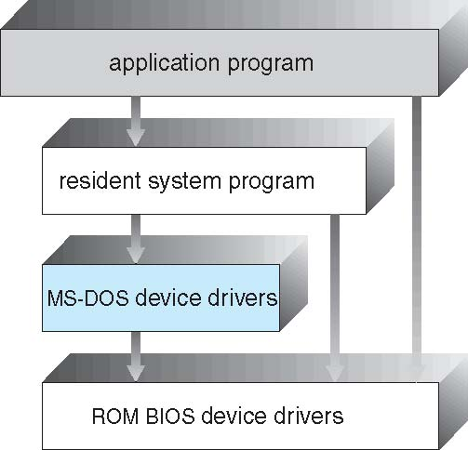
Simple Structure -- MS-DOS
MS-DOS – written to provide the most functionality in the least space.
Not divided into modules.
Although MS-DOS has some structure, its interfaces and levels of functionality are not well separated.

Slide 38
Non Simple Structure -- UNIX
UNIX – limited by hardware functionality, the original UNIX operating system had limited structuring. The UNIX OS consists of two separable parts:
Systems programs
The kernel.
Consists of everything below the system-call interface and above the physical hardware.
Provides the file system, CPU scheduling, memory management, and other operating-system functions; a large number of functions for one level.

Slide 39
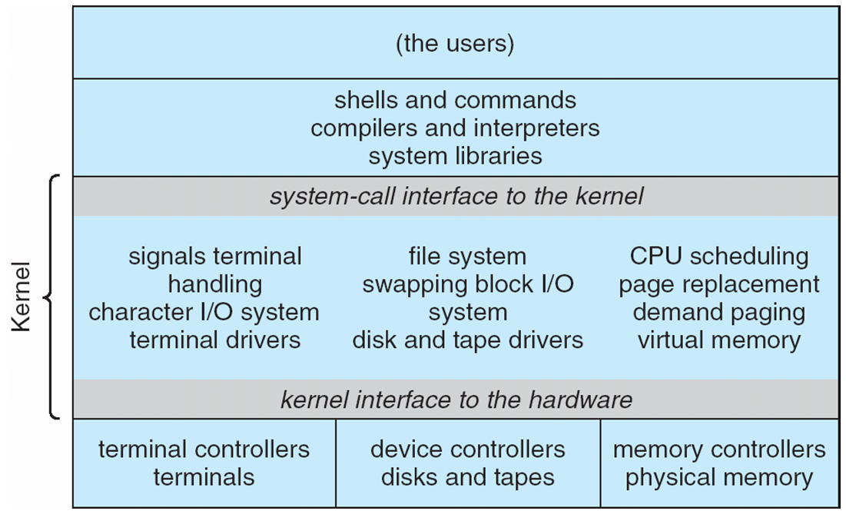
Traditional UNIX System Structure
Beyond simple but not fully layered

Slide 40
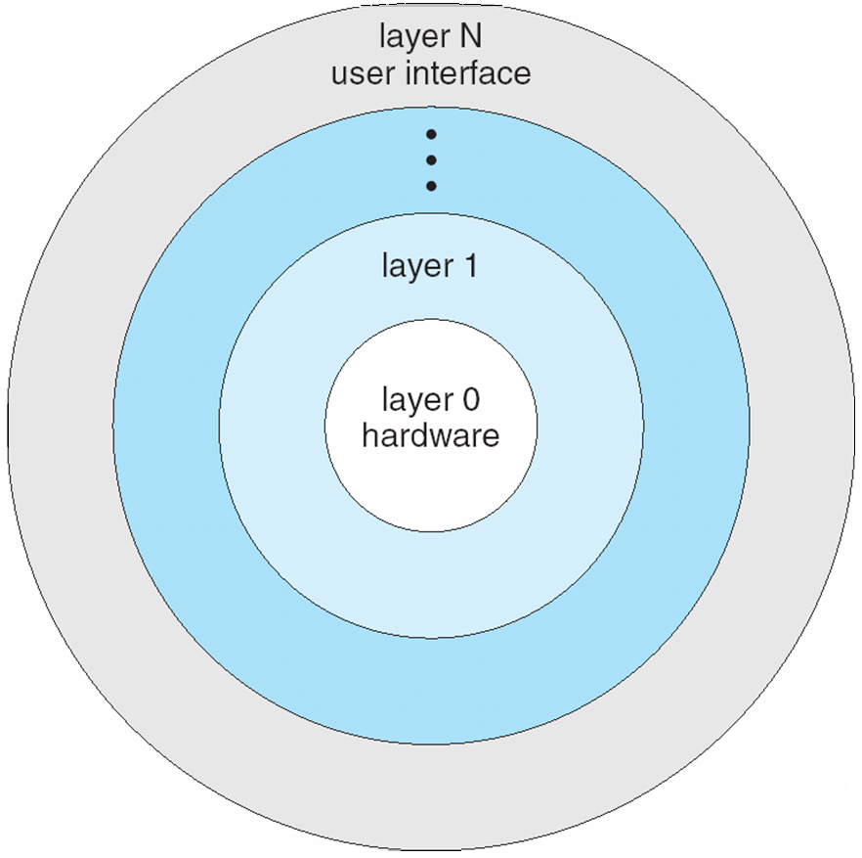
Layered Approach
The operating system is divided into a number of layers (levels), each built on top of lower layers. The bottom layer (layer 0), is the hardware; the highest (layer N) is the user interface.
With modularity, layers are selected such that each uses functions (operations) and services of only lower-level layers.

Slide 41
Microkernel System Structure
Moves as much from the kernel into user space.
Mach example of microkernel
Mac OS X kernel (Darwin) partly based on Mach
Communication takes place between user modules using message passing.
Benefits:
Easier to extend a microkernel.
Easier to port the operating system to new architectures.
More reliable (less code is running in kernel mode).
More secure.
Detriments:
Performance overhead of user space to kernel space communication.

Slide 42
Microkernel System Structure

Slide 43
Modules
Many modern operating systems implement loadable kernel modules
Uses object-oriented approach
Each core component is separate
Each talks to the others over known interfaces
Each is loadable as needed within the kernel
Overall, similar to layers but with more flexible
Linux, Solaris, etc

Slide 44
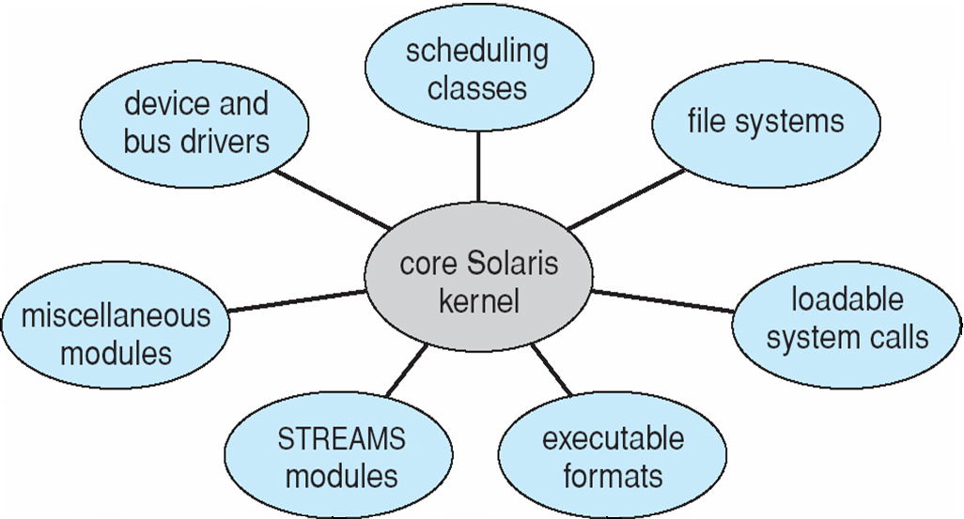
Solaris Modular Approach

Slide 45
Hybrid Systems
Most modern operating systems are actually not one pure model.
Hybrid combines multiple approaches to address performance, security, usability needs.
Linux and Solaris kernels in kernel address space, so monolithic, plus modular for dynamic loading of functionality.
Windows mostly monolithic, plus microkernel for different subsystem personalities.
Apple Mac OS X hybrid, layered, Aqua UI plus Cocoa programming environment.
Below is kernel consisting of Mach microkernel and BSD Unix parts, plus I/O kit and dynamically loadable modules (called kernel extensions).

Slide 46
Mac OS X Structure

Slide 47
iOS
Apple mobile OS for iPhone, iPad
Structured on Mac OS X, added functionality.
Does not run OS X applications natively.
Also runs on different CPU architecture (ARM vs. Intel).
Cocoa Touch Objective-C API for developing apps.
Media services layer for graphics, audio, video.
Core services provides cloud computing, databases.
Core operating system, based on Mac OS X kernel.

Slide 48
Android
Developed by Open Handset Alliance (mostly Google).
Open Source
Similar stack to IOS
Based on Linux kernel but modified.
Provides process, memory, device-driver management.
Adds power management.
Runtime environment includes core set of libraries and Dalvik virtual machine.
Apps developed in Java plus Android API.
Java class files compiled to Java bytecode then translated to executable than runs in Dalvik VM.
Libraries include frameworks for web browser (webkit), database (SQLite), multimedia, smaller libc.

Slide 49
Android Architecture

Slide 50
Operating-System Debugging
Debugging is finding and fixing errors, or bugs.
OS generate log files containing error information.
Failure of an application can generate core dump file capturing memory of the process.
Operating system failure can generate crash dump file containing kernel memory.
Beyond crashes, performance tuning can optimize system performance.
Sometimes using trace listings of activities, recorded for analysis
Profiling is periodic sampling of instruction pointer to look for statistical trends
Kernighan’s Law: “Debugging is twice as hard as writing the code in the first place. Therefore, if you write the code as cleverly as possible, you are, by definition, not smart enough to debug it.”

Slide 51
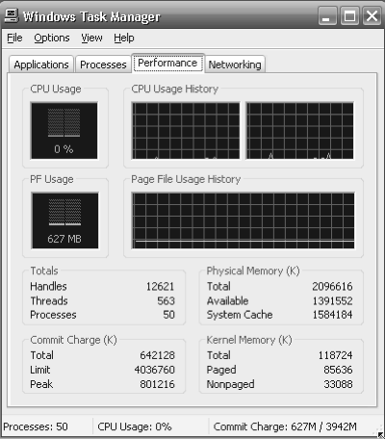
Performance Tuning
Improve performance by removing bottlenecks.
OS must provide means of computing and displaying measures of system behavior.
For example, “top” program or Windows Task Manager.

Slide 52
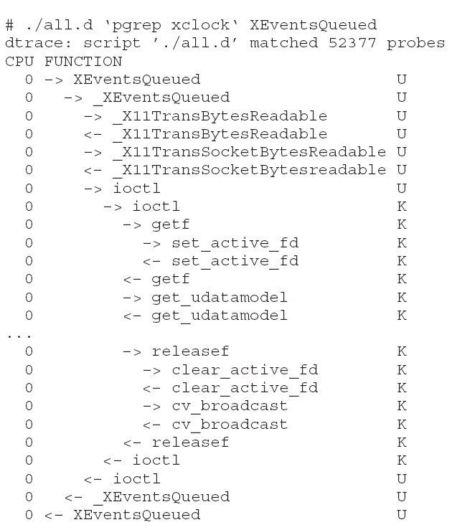
DTrace
DTrace tool in Solaris, FreeBSD, Mac OS X allows live instrumentation on production systems.
Probes fire when code is executed within a provider, capturing state data and sending it to consumers of those probes.
Example of following XEventsQueued system call move from libc library to kernel and back.

Slide 53
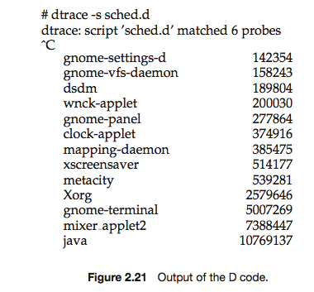
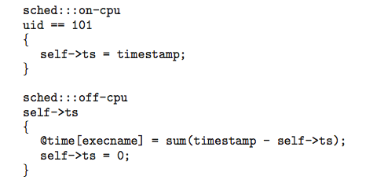
Dtrace (Cont.)
DTrace code to record amount of time each process with UserID 101 is in running mode (on CPU) in nanoseconds

Slide 54
Operating System Generation
Operating systems are designed to run on any of a class of machines; the system must be configured for each specific computer site.
SYSGEN program obtains information concerning the specific configuration of the hardware system
Used to build system-specific compiled kernel or system-tuned.
Can general more efficient code than one general kernel.

Slide 55
System Boot
When power initialized on system, execution starts at a fixed memory location.
Firmware ROM used to hold initial boot code.
Operating system must be made available to hardware so hardware can start it.
Small piece of code – bootstrap loader, stored in ROM or EEPROM locates the kernel, loads it into memory, and starts it
.Sometimes two-step process where boot block at fixed location loaded by ROM code, which loads bootstrap loader from disk.
Common bootstrap loader, GRUB, allows selection of kernel from multiple disks, versions, kernel options.
Kernel loads and system is then running.

Slide 56
End of Chapter 2

